Slide 1

Web Development Learning Journey
This presentation outlines a structured roadmap for aspiring front-end developers, guiding them from foundational HTML to advanced responsive design. Each module is designed to build progressively, with hands-on assignments that reinforce learning and lead to the creation of real-world web projects. Join us as we walk through each essential module and its corresponding practical assignment.

Slide 2



Module 1: HTML Basics
Foundational Building Blocks
Crafting User Forms
Semantic HTML Structure
Learn how to structure web page content using core HTML tags and elements. This module covers the essential syntax that forms the backbone of any website.
Understand the creation of interactive user input forms using elements like <form>, <input>, and <textarea> to collect data.
Dive into semantic HTML5 elements (e.g., <header>, <nav>, <article>, <footer>) to ensure meaningful content organisation and improved accessibility.
Assignment: Create a Personal Bio Webpage
Your first hands-on task: design a single-page website about yourself. It must include your name, a profile photo, a short descriptive paragraph, and a functional contact form. Crucially, ensure the entire page is structured with proper semantic HTML for clarity and accessibility.

Slide 3
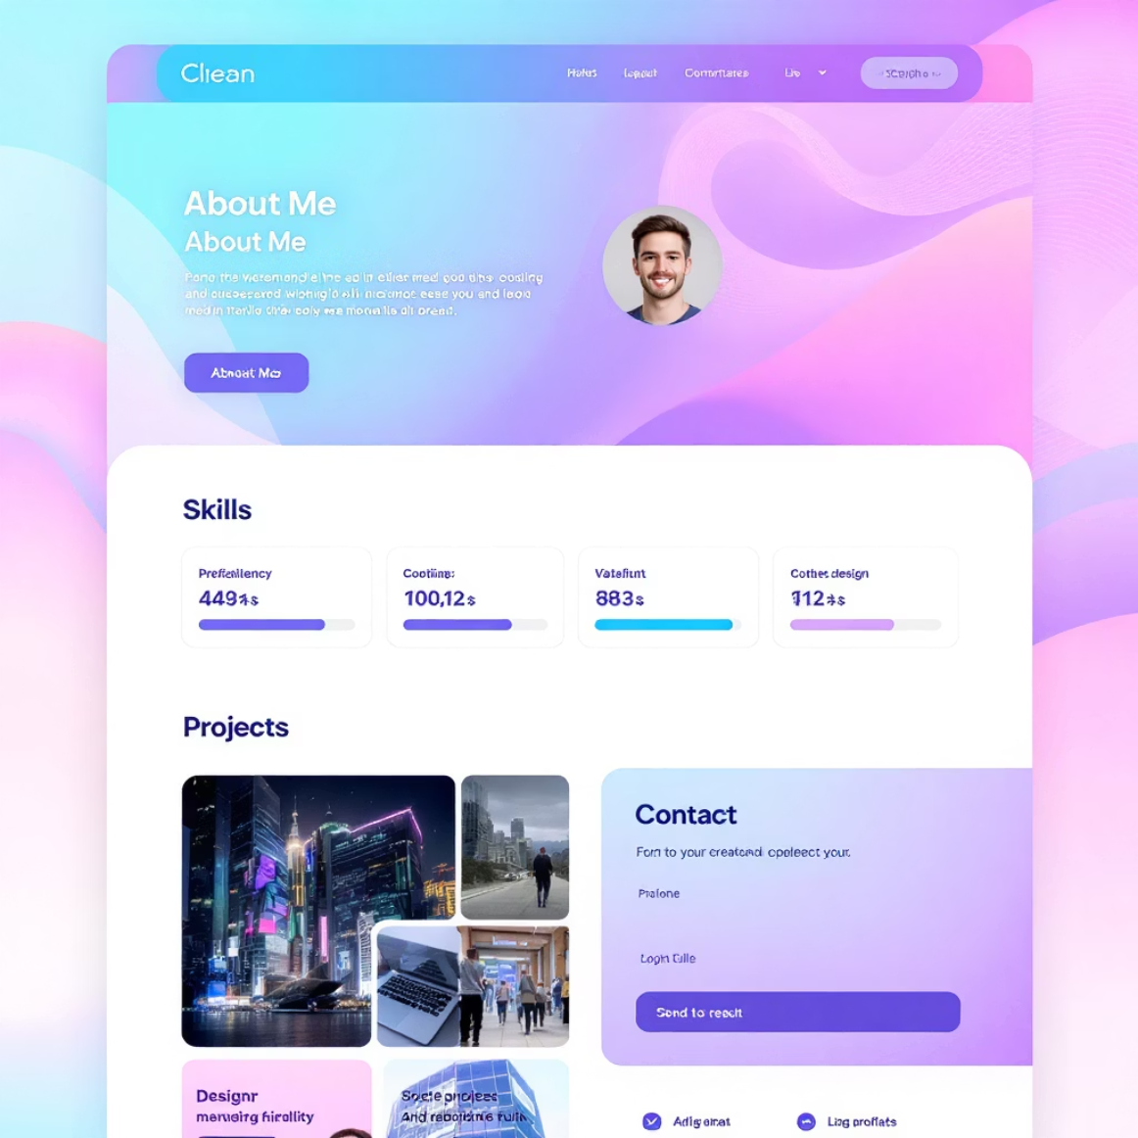




Module 2: CSS Fundamentals
Transform plain HTML into visually appealing web pages with CSS styling fundamentals.
CSS Selectors
Target HTML elements using class, ID, element, and pseudo-class selectors.
Box Model
Control element spacing with margin, padding, and borders.
Flexbox Layout
Create responsive one-dimensional layouts for navigation and component alignment.
Typography
Choose fonts, line heights, and spacing for optimal readability.
Assignment: Styled Portfolio Layout
Create a personal portfolio using CSS and Flexbox with "About Me," "Skills," "Projects," and "Contact" sections.

Slide 4
Module 3: Advanced CSS Techniques
Elevate your web designs with dynamic and sophisticated CSS capabilities. This module focuses on creating engaging user experiences through motion and complex layouts.
1
2
3
Transitions & Animations
CSS Grid Layouts
Pseudo-Elements & Selectors
Implement smooth hover effects and compelling CSS transitions to enhance interactivity. Learn to create intricate animations for a modern user experience.
Master CSS Grid for building robust and intricate two-dimensional page layouts, offering unparalleled control over content placement.
Utilise ::before and ::after pseudo-elements to add decorative content or styling without altering the HTML structure.
Assignment: Product Card Grid
Build a visually engaging grid of product cards. Each card must feature a responsive grid layout, smooth transitions on hover, and stylish buttons with subtle shadows, showcasing your command of advanced CSS properties.

Slide 5



Module 4: Bootstrap Framework
Accelerate your development workflow by leveraging Bootstrap, the world's most popular front-end open source toolkit. Learn to build responsive, mobile-first projects quickly and efficiently.
Responsive Grid System
Pre-built Components
Utility Classes
Understand and implement Bootstrap's powerful responsive grid system for consistent and adaptable layouts across all device sizes.
Integrate a wide array of pre-built components like navbars, modals, carousels, and cards to construct rich, interactive user interfaces rapidly.
Utilise Bootstrap's extensive collection of utility classes for quick styling, spacing, typography, and responsive adjustments without writing custom CSS.
Assignment: Landing Page Recreation
Recreate a professional landing page (e.g., for a startup, e-commerce site, or portfolio) entirely using Bootstrap. Ensure it incorporates a responsive navbar, a compelling hero section, feature cards, and a styled form, all built with Bootstrap components and utilities.

Slide 6
Module 5: Responsive Design Deep Dive
Master the critical principles of responsive web design to ensure your websites provide an optimal viewing and interaction experience across a wide range of devices, from mobile phones to desktop monitors.
Media Queries for Adaptability
Mobile-First Approach
Web Accessibility (A11y)
Learn to use CSS Media Queries effectively to apply different styles based on device characteristics such as screen width, height, and orientation.
Embrace the mobile-first design strategy, beginning your design and development for smaller screens and progressively enhancing for larger ones, ensuring superior performance and user experience.
Integrate accessibility best practices, including semantic HTML, colour contrast, proper alt text for images, and keyboard navigation, to ensure your websites are usable by everyone, regardless of ability.
Assignment: Enhance Bootstrap Project
Take your Week 4 Bootstrap project and transform it into a fully responsive website. Your task is to ensure the layout adapts seamlessly across mobile, tablet, and desktop devices. Rigorously test responsiveness on various screen sizes and refine the user experience (UX) to perfection.

Slide 7
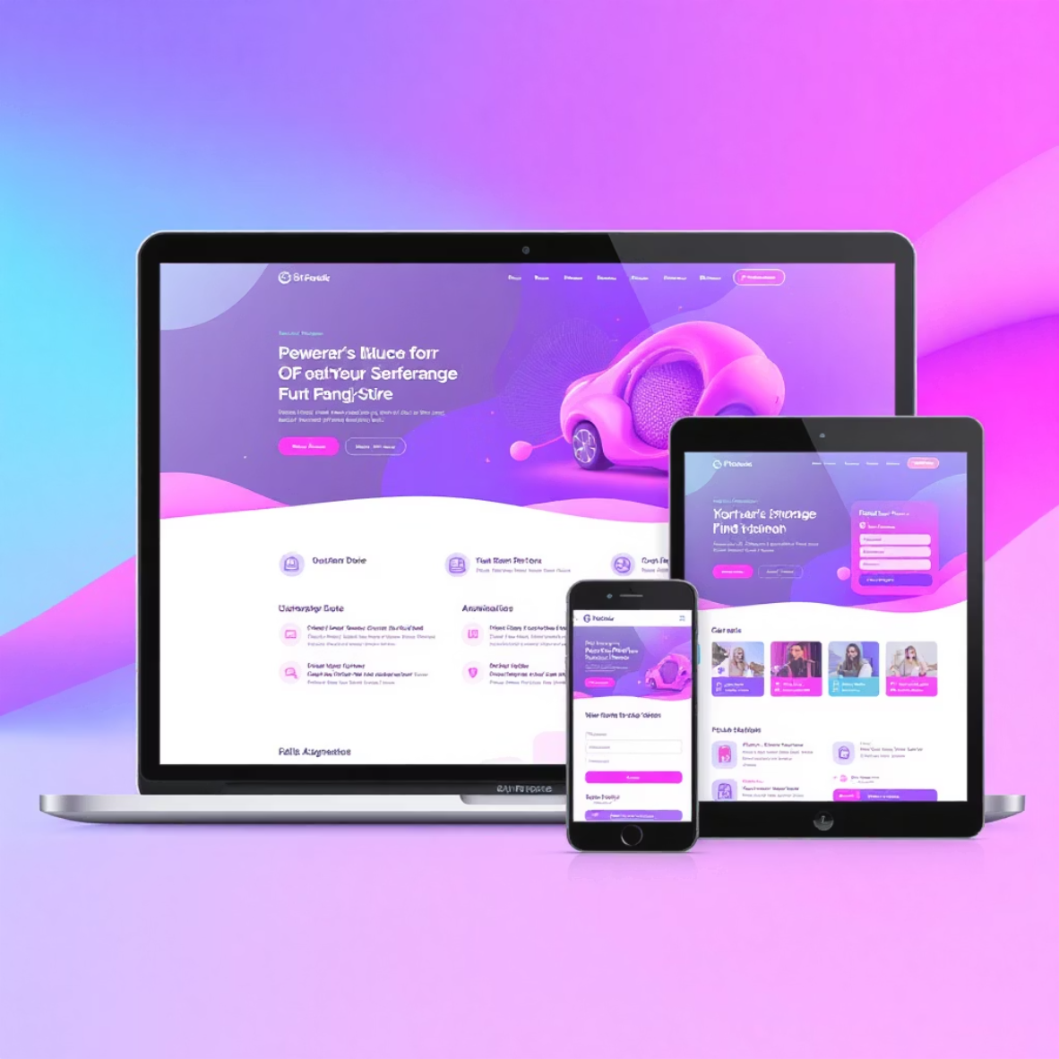
Module 6: Final Project & Evaluation
Synthesise all course knowledge into a comprehensive web development project that showcases your capabilities.
1
2
3
1
Integrated Learning
Combine HTML, CSS, responsive design, and Bootstrap into a cohesive, functional website.
2
Full UI Implementation
Build a complete user interface for a fictional product or personal portfolio.
3
Quality & Usability
Ensure clean code, responsive design, and accessibility standards.
Final Project: Build a Complete Website
Create a comprehensive website with dynamic navigation, multiple sections, interactive forms, and CSS animations that functions seamlessly across all devices.

